Slide 1
Getting Started with Shiny
Stockholm R-Ladies Meetup #2
2018-11-14

Slide 2
Why Shiny?

Slide 3
Apps for exploratory data analysis

Slide 4
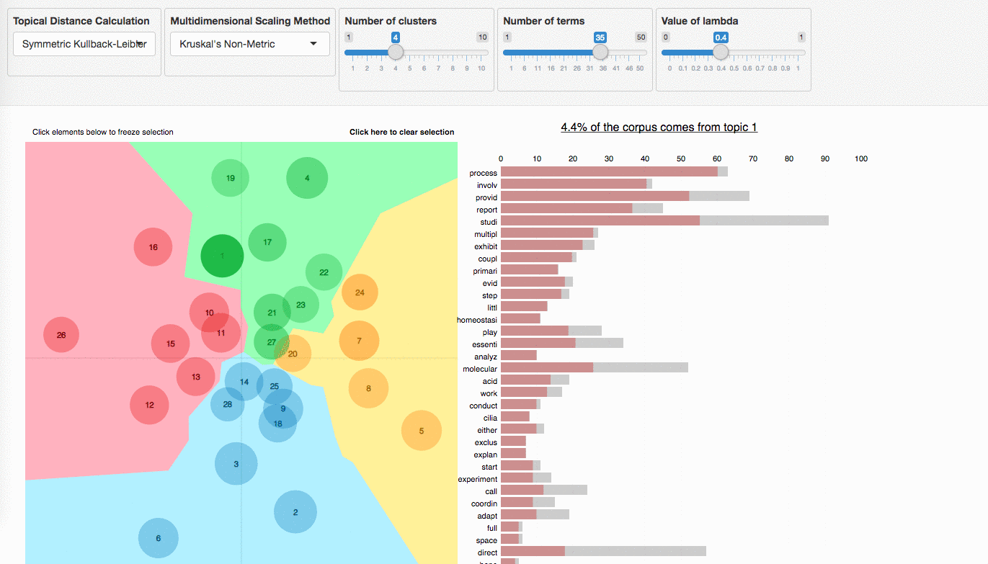

Slide 5
Web pages with interactive dataviz

Slide 6


Slide 7
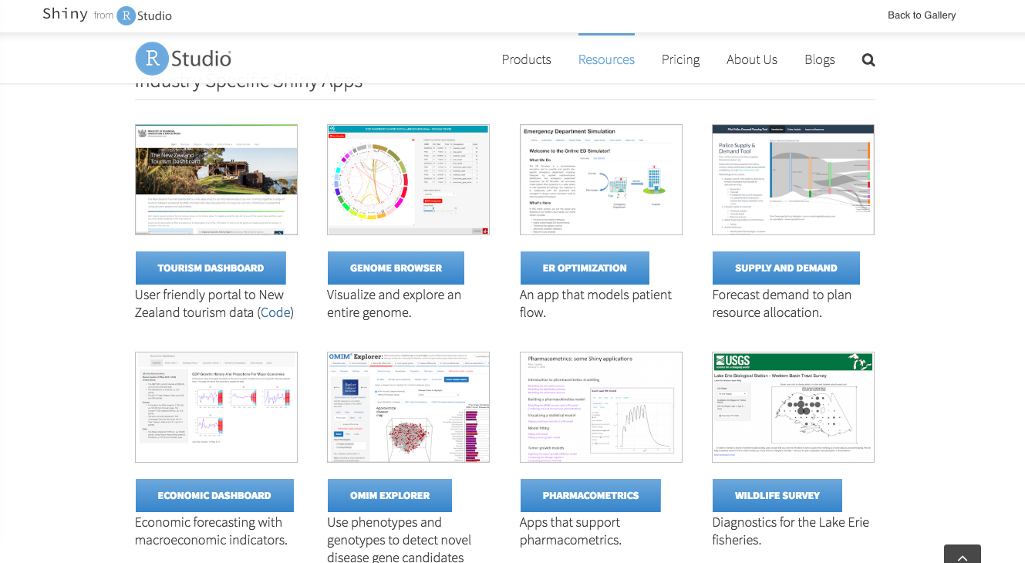
Shiny User Showcase

Slide 8
Today’s app will answer one of the most common weekend questions…

Slide 9
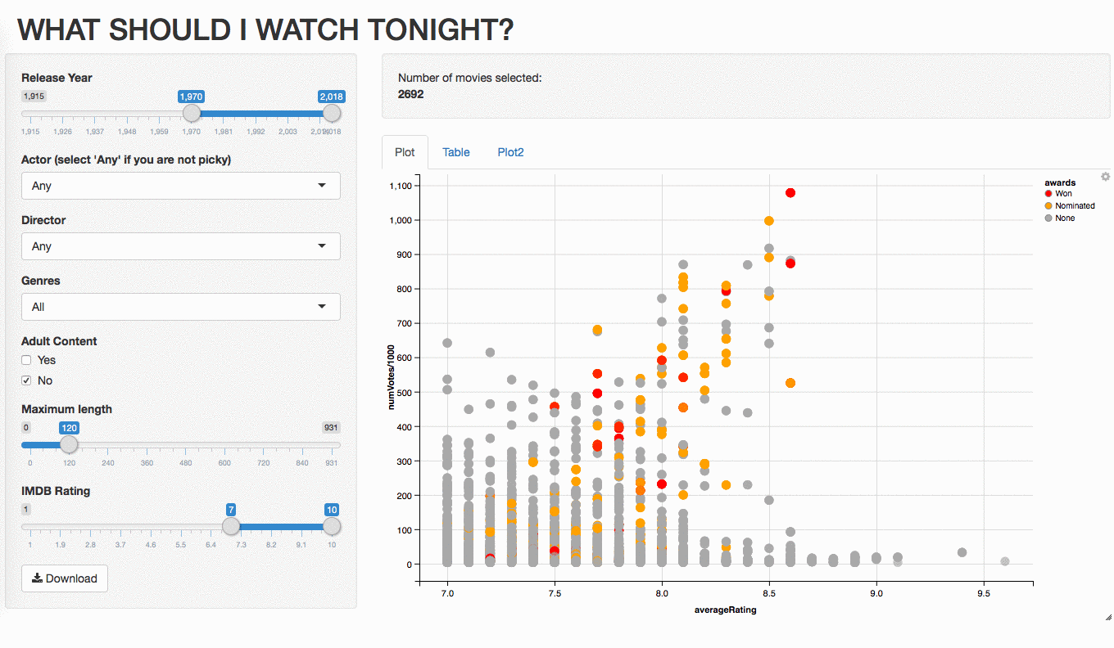

Slide 10
1
2
3
4
5
6
7
8
9
10
Preparation
UI
Server
Extras

Slide 11


1. Get the data
+
Data on ratings, directors, actors,
genres, length, etc.
Data on Oscar nominations

Slide 12
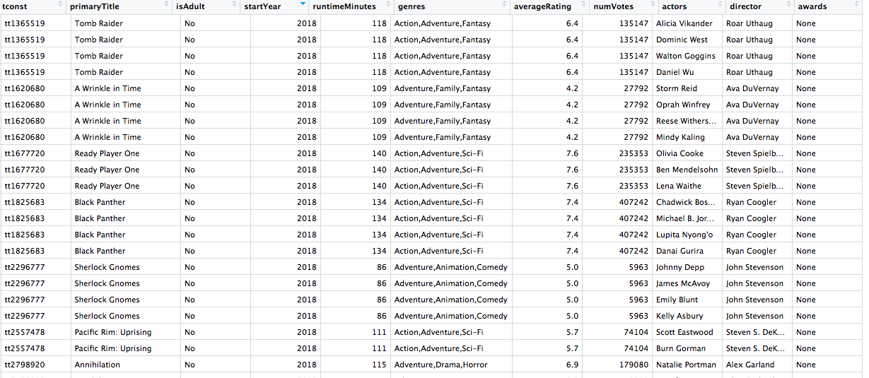

Slide 13
2. Start with “the template”
library(shiny)
ui <- fluidPage()
server <- function(input, output){}
shinyApp(ui = ui, server = server)

Slide 14
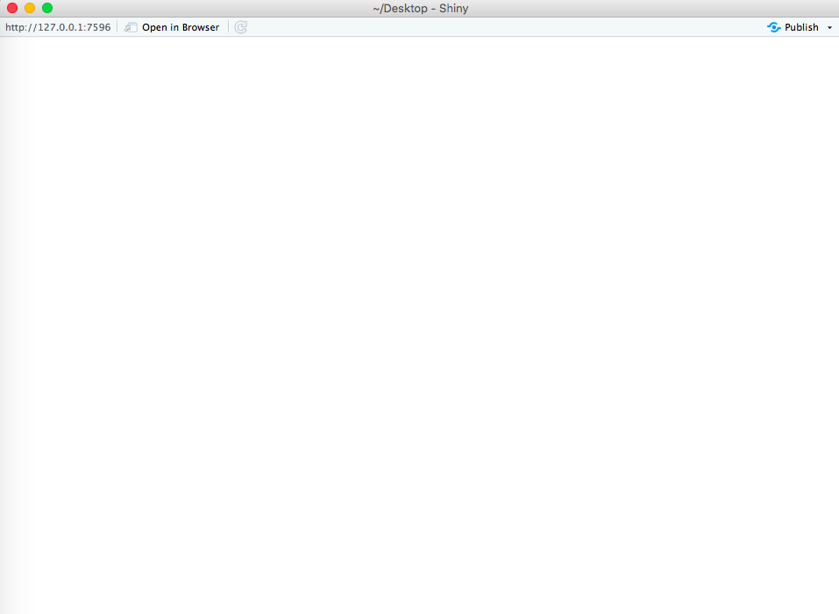
2. Start with “the template”
library(shiny)
ui <- fluidPage()
server <- function(input, output){}
shinyApp(ui = ui, server = server)

Slide 15
2. Start with “the template”
library(shiny)
ui <- fluidPage(
)
server <- function(input, output){}
shinyApp(ui = ui, server = server)
Inputs
Outputs
Inputs
Outputs

Slide 16
2. Start with “the template”
library(shiny)
ui <- fluidPage(
)
server <- function(input, output){
}
shinyApp(ui = ui, server = server)
Inputs
Outputs
Inputs
Outputs
Outputs
Inputs

Slide 17
3. Read data into the app
library(shiny)
movies_data <- data.table::fread(”movies.csv")
ui <- fluidPage()
server <- function(input, output){}
shinyApp(ui = ui, server = server)

Slide 18
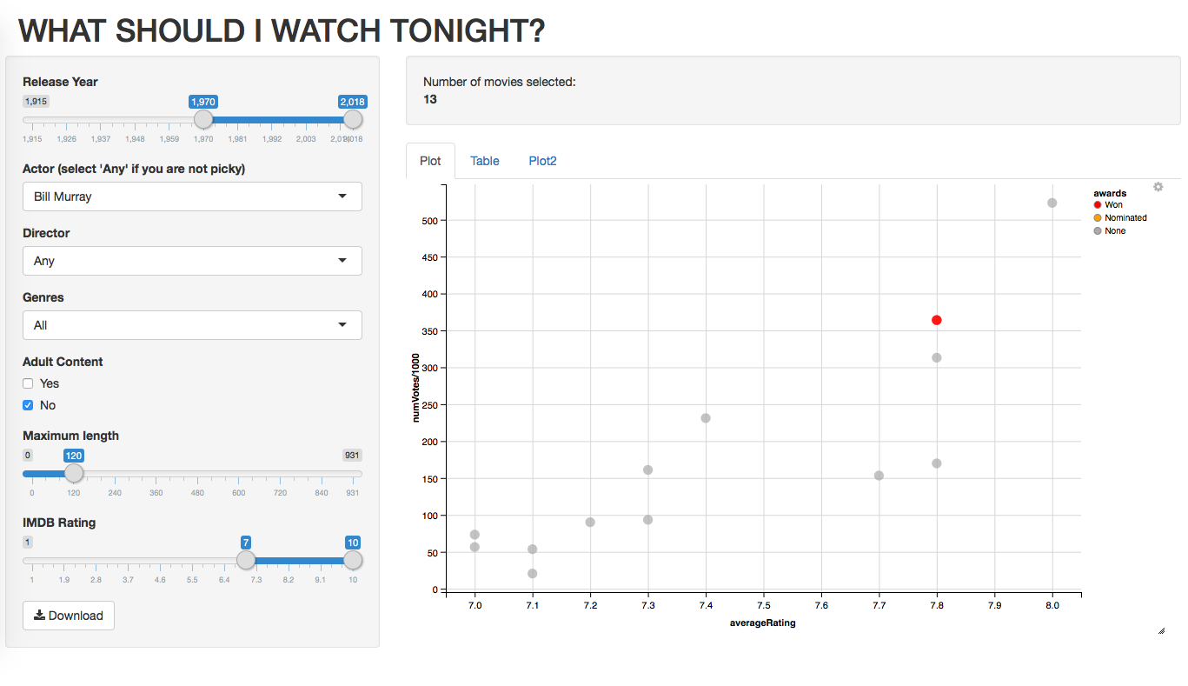
4. Create layout
*Panel() functions
headerPanel()
tabsetPanel()
+ tabPanel()
mainPanel()
+ sidePanel()
*Layout() functions
sidebarLayout()

Slide 19
4. Create layout
*Panel() functions
headerPanel()
tabsetPanel()
+ tabPanel()
mainPanel()
+ sidePanel()
*Layout() functions
sidebarLayout()

Slide 20
4. Create layout
*Panel() functions
headerPanel()
tabsetPanel()
+ tabPanel()
mainPanel()
+ sidebarPanel()
*Layout() functions
sidebarLayout()

Slide 21
4. Create layout
*Panel() functions
headerPanel()
tabsetPanel()
+ tabPanel()
mainPanel()
+ sidePanel()
*Layout() functions
sidebarLayout()

Slide 22
4. Create layout
*Panel() functions
headerPanel()
tabsetPanel()
+ tabPanel()
mainPanel()
+ sidePanel()
*Layout() functions
sidebarLayout()

Slide 23
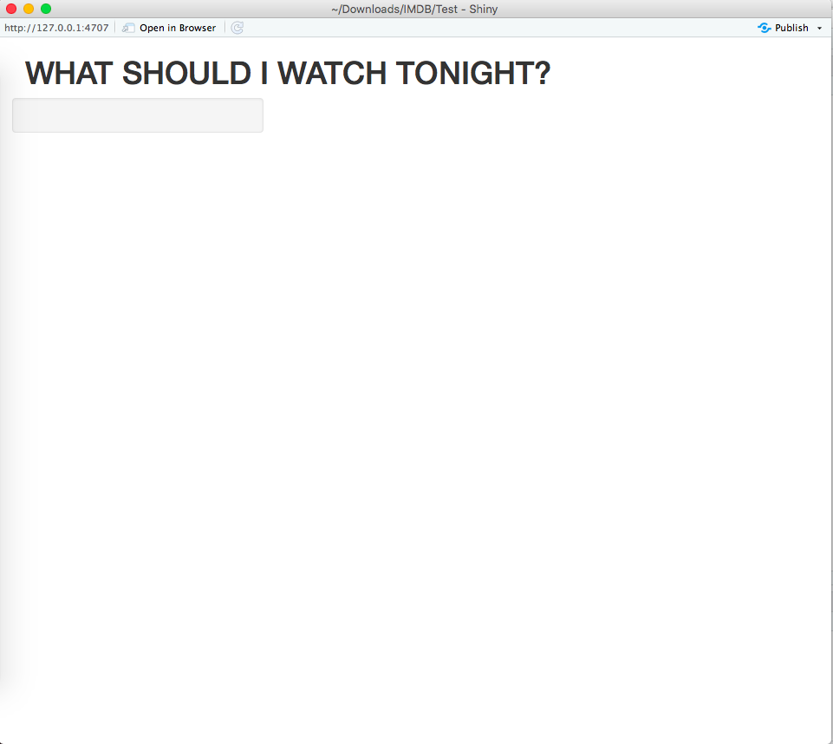
4. Create layout
ui <- fluidPage(
titlePanel("WHAT SHOULD I WATCH TONIGHT?"),
sidebarLayout( sidebarPanel(),
mainPanel()
)
)
)
SIDEBAR
MAIN

Slide 24
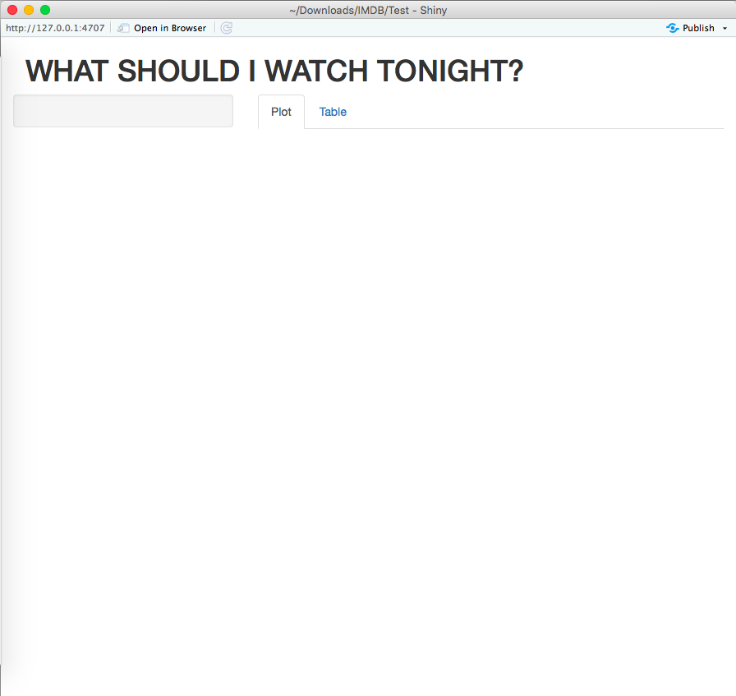
4. Create layout
ui <- fluidPage(
titlePanel("WHAT SHOULD I WATCH TONIGHT?"),
sidebarLayout( sidebarPanel(),
mainPanel(
tabsetPanel(
tabPanel("Plot"),
tabPanel("Table")))))
TAB

Slide 25
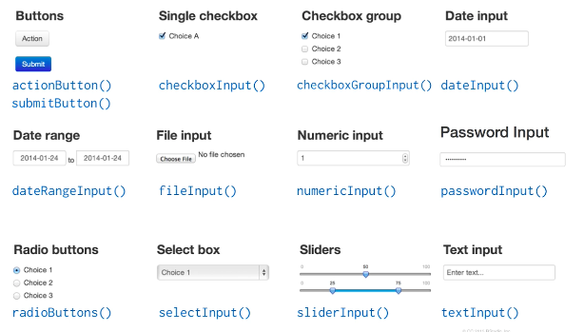
5. Create input widgets

Slide 26
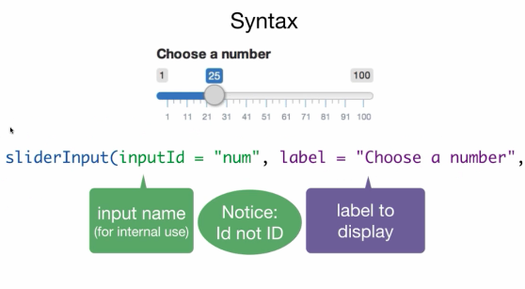
5. Create input widgets
Source: R-Studio tutorial

Slide 27
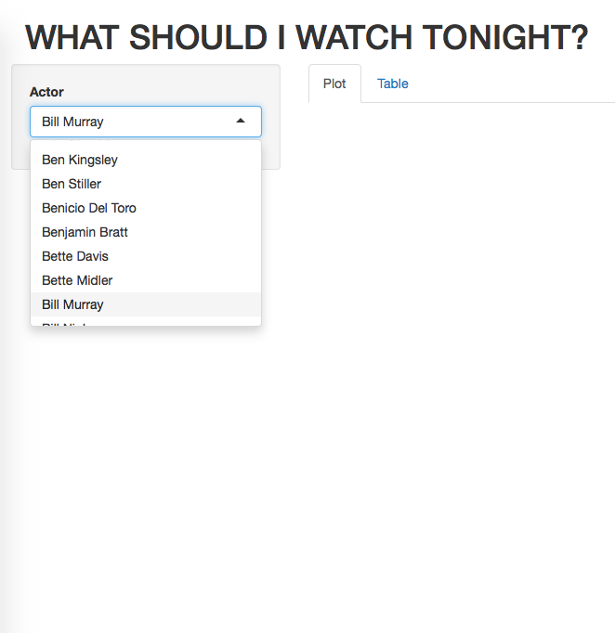
5. Create input widgets
sidebarPanel(
selectInput(
inputId = "actor",
label = "Actor",
choices = c("Any", actor_list), selected = 'Bill Murray’
)
)

Slide 28
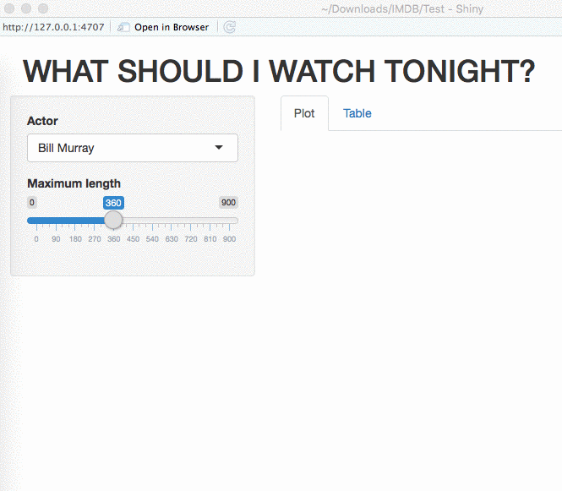
5. Create input widgets
sidebarPanel(
selectInput(
inputId = "actor",
label = "Actor",
choices = c("Any", actor_list), selected = 'Bill Murray’
),
sliderInput(
inputId = "length", label = "Maximum length", min = 0, max = 900, value = 120,
step = 30)
)

Slide 29
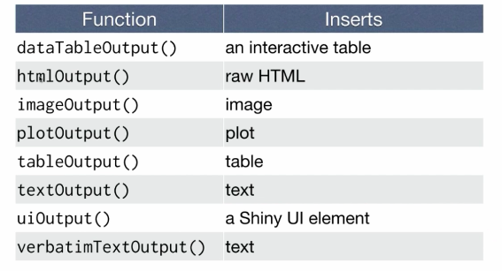
6. Create output placeholders

Slide 30
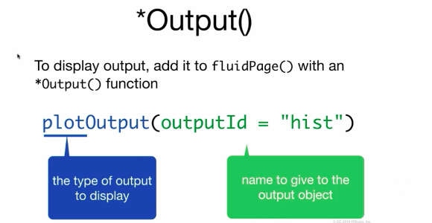
6. Create output placeholders
Source: R-Studio tutorial

Slide 31
6. Create output placeholders
mainPanel(
tabsetPanel(
tabPanel("Plot", plotOutput(outputId = "plot")),
tabPanel("Table",
tableOutput(outputId = "table")))
)

Slide 32
7. Make outputs react to the inputs
server <- function(input, output){
output$table <- renderTable({
movies_data %>%
filter(runtimeMinutes <= input$length)
})
RULE 1. Save elements to output$*

Slide 33
7. Make outputs react to the inputs
server <- function(input, output){
output$table <- renderTable({
movies_data %>%
filter(runtimeMinutes <= input$length)
})
RULE 2. Build objects to display with render*(). Render functions prepares R objects for HTML

Slide 34
7. Make outputs react to the inputs
server <- function(input, output){
output$table <- renderTable({
movies_data %>%
filter(runtimeMinutes <= input$length)
})
RULE 3. Use input values with input$

Slide 35
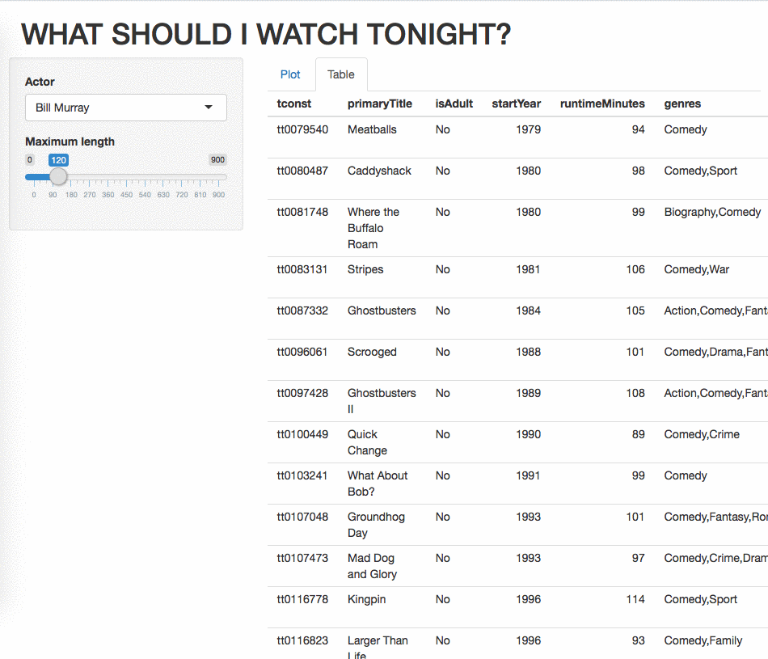
7. Make outputs react to the inputs: Table
server <- function(input, output){
output$table <- renderTable({
movies <- movies_data %>%
filter(runtimeMinutes <= input$length)
if(input$actor != "Any") {
movies_data <- movies_data %>% filter(actors == input$actor)}
})

Slide 36
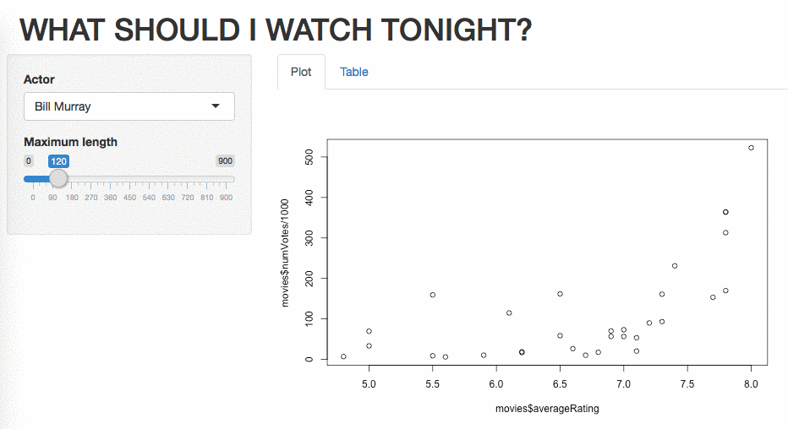
7a. Make outputs react to the inputs: Plot
server <- function(input, output){
output$plot <- renderPlot({
movies <- movies_data %>%
filter(runtimeMinutes <= input$length)
if(input$actor != "Any") {
Movies <- movies %>% filter(actors == input$actor)}
plot(movies$averageRating, movies$numVotes/1000)
})
}

Slide 37
8. Reuse data for multiple outputs
TABLE
PLOT
server <- function(input, output){
output$table <- renderTable({
movies <- movies_data %>%
filter(runtimeMinutes <= input$length)
if(input$actor != "Any") {
movies <- movies %>%
filter(actors == input$actor)}
})
server <- function(input, output){
output$plot <- renderPlot({
movies <- movies_data %>%
filter(runtimeMinutes <= input$length)
if(input$actor != "Any") {
movies <- movies %>%
filter(actors == input$actor)}
plot(movies$averageRating, movies$numVotes/1000)
})

Slide 38
8. Reuse data for multiple outputs
server <- function(input, output){
movies <- movies_data %>%
filter(runtimeMinutes <= input$length)
if(input$actor != "Any") {
movies <- movies %>%
filter(actors == input$actor)}
output$table <- renderTable({
movies})
output$plot <- renderPlot({
plot(movies$averageRating, movies$numVotes/1000)})
}

Slide 39
8. Reuse data for multiple outputs
server <- function(input, output){
movies <- movies_data %>%
filter(runtimeMinutes <= input$length)
if(input$actor != "Any") {
movies <- movies %>%
filter(actors == input$actor)}
output$table <- renderTable({
movies})
output$plot <- renderPlot({
plot(movies$averageRating, movies$numVotes/1000)})
}
Error in filter_impl(.data, quo) :
Evaluation error: Operation not allowed without an active reactive context. (You tried to do something that can only be done from inside a reactive expression or observer.).

Slide 40
8. Reuse data for multiple outputs
server <- function(input, output){
data <- reactive ({
movies <- movies_data %>%
filter(runtimeMinutes <= input$length)
if(input$actor != "Any") {
movies <- movies %>%
filter(actors == input$actor)} })
output$table <- renderTable({
data()})
output$plot <- renderPlot({
plot(data()$averageRating, data()$numVotes/1000)})
}
Wrap reactive() function around your data

Slide 41
8. Reuse data for multiple outputs
server <- function(input, output){
data <- reactive ({
movies <- movies_data %>%
filter(runtimeMinutes <= input$length)
if(input$actor != "Any") {
movies <- movies %>%
filter(actors == input$actor)} })
output$table <- renderTable({
data()})
output$plot <- renderPlot({
plot(data()$averageRating, data()$numVotes/1000)})
}
Wrap reactive() function around your data
Save it into an object (e.g. ‘data’)

Slide 42
8. Reuse data for multiple outputs
server <- function(input, output){
data <- reactive ({
movies <- movies_data %>%
filter(runtimeMinutes <= input$length)
if(input$actor != "Any") {
movies <- movies %>%
filter(actors == input$actor)} })
output$table <- renderTable({
data()})
output$plot <- renderPlot({
plot(data()$averageRating, data()$numVotes/1000)})
}
Wrap reactive() function around your data
Save it into an object (e.g. ‘data’)
Call that object from other outputs as a function

Slide 43
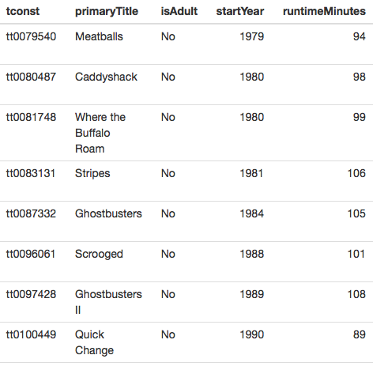
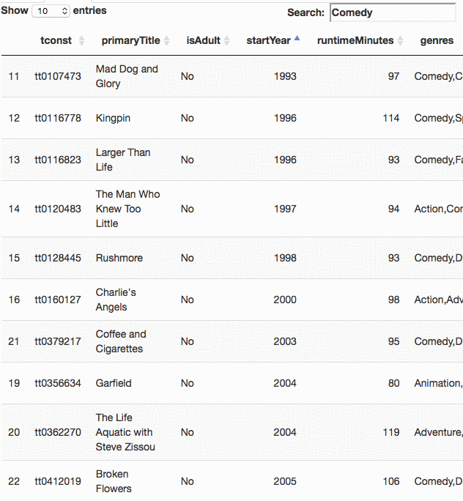
9. Make prettier tables with DT
Basic Table
library(DT)

Slide 44
9. Make prettier tables with DT
Basic Table
library(DT)
tableOutput("table")
dataTableOutput("table")
output$table <- renderTable({
movies()
})
output$table <- renderDataTable({
movies()
})

Slide 45
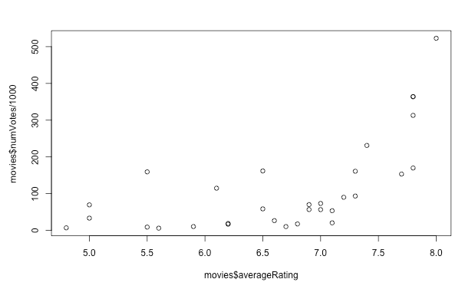
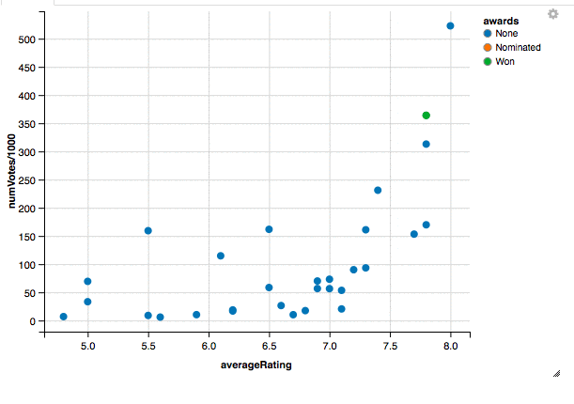
10. Make better plots with ggvis
Basic Plot
library(ggvis)

Slide 46
10. Make better plots with ggvis
Basic Plot
library(ggvis)
plotOutput(”plot")
ggvisOutput("plot")
output$plot <- renderPlot({
plot(
x = data()$averageRating,
y = data()$numVotes/1000)})
vis <- reactive({ movies %>%
ggvis(~averageRating, ~numVotes/1000,
key := ~primaryTitle) %>%
layer_points(fill = ~awards) %>%
add_tooltip(tooltip, "hover")
})
vis %>% bind_shiny("plot")

Slide 47
Publish your app to shinyapps.io

Slide 48
Other things we could do…
Create a “Download” button to download the data
Create an “Apply” button to render outputs only after a user is done with specifying all the inputs
Update table when a user hovers over the plot
Etc.

Slide 49
Useful Materials
Cheat Sheet
https://www.rstudio.com/resources/cheatsheets/
Examples
http://www.showmeshiny.com/
https://shiny.rstudio.com/gallery/
Tutorials
By Garret Grolemund https://shiny.rstudio.com/tutorial/#written-tutorials
By Dean Attali https://deanattali.com/blog/building-shiny-apps-tutorial/

